Slide 1
Revision of the Long Island Sound Study Comprehensive Conservation and Management Plan (CCMP)
CT Public Listening Session
June 26, 2013

Slide 2
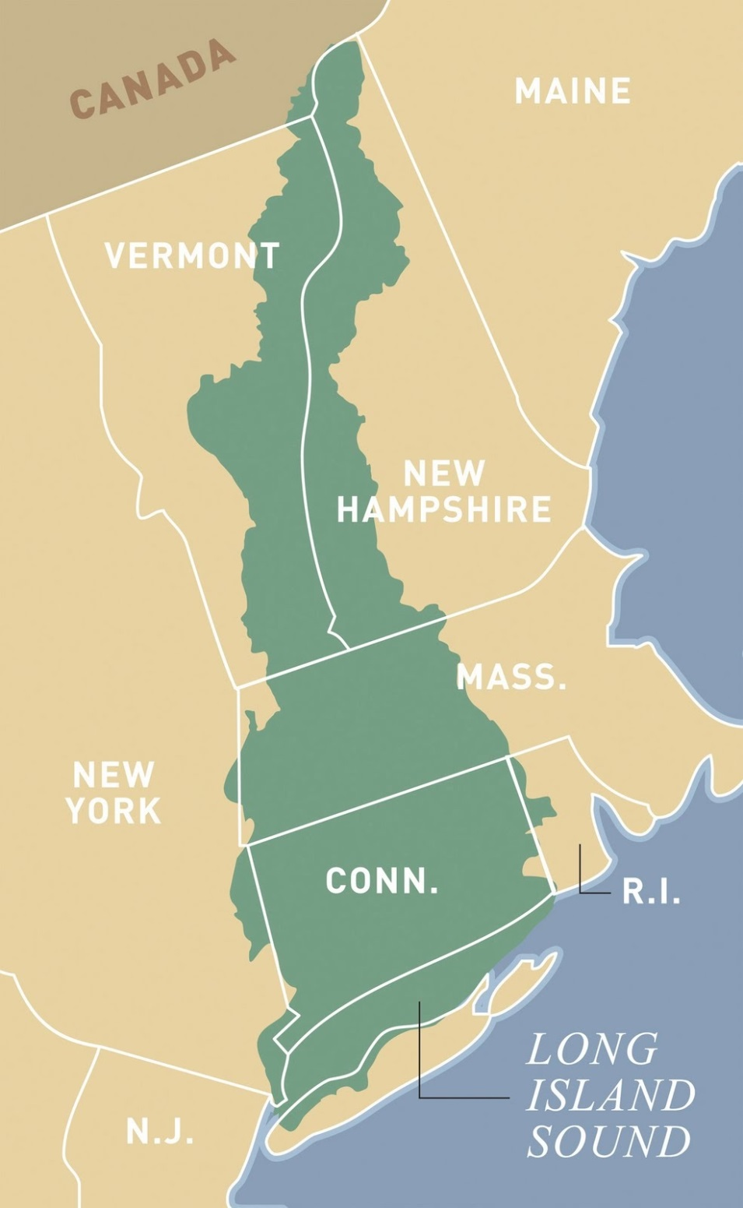
Long Island Sound Watershed
Contributing Connecticut Rivers
Connecticut River | Quinnipiac River
Housatonic River | Rooster River/Ash Creek
Mill River | Rippowam River
Norwalk River | Saugatuck River
Pequonnock River | Thames River
West River | Byram River
Mamaroneck River

Slide 3
What is a CCMP?
The Comprehensive Conservation and Management Plan identifies the specific commitments and recommendations for actions to improve water quality, protect habitat and living resources, educate and involve the public, improve the long-term understanding of how to manage the Sound, monitor progress, and direct management efforts.
The Long Island Sound Study uses the CCMP as a blueprint to develop management implementation strategies for short and long term goals. The first CCMP, together with the TMDL, was instrumental in leveraging major infrastructure improvements leading to dramatic decreases in nitrogen loading.

Slide 4
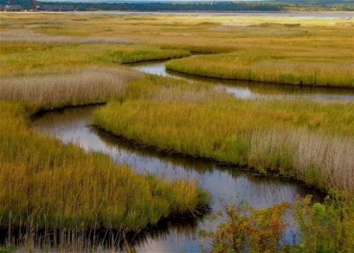
If It Ain’t Broke Why Fix It?
First CCMP completed in 1994
Focused on 6 elements:
Low DO (hypoxia)
Toxic contamination
Pathogens
Floatable debris
Water quality effects on habitat and living marine resources
Development effects on water quality
Main accomplishments
It established a framework for protection of LIS
Not addressed or only noted briefly in 1994:
Climate change
Ecosystem services
Harbors and embayments of LIS
Bioextraction

Slide 5
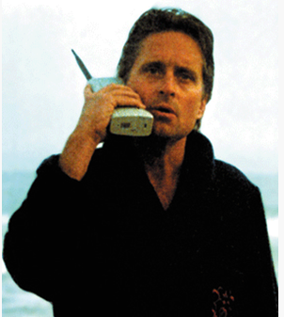
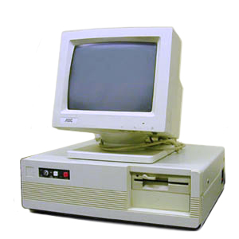
Why revise the 1994 CCMP?
Incorporate advances in management
Incorporate advances in science
Incorporate new drivers and environmental pressures

Slide 6
LISS CCMP Revision Timeline
CCMP Content Development
CCMP Revision
CCMP draft development
Oct 1, 2013
Planning & Organization
Public/ Stakeholder Input
CCMP Approval
Public
Comment
2011 | 2012 | 2013 | 2014 | 2015
FY13 Budget Cycle
Kick off
Dec 1, 2011
Lead coordinator begins assisting
July 2012
CCMP draft
completion
Dec 31, 2013
CCMP complete
Sep 30, 2014
We are here
Contractor Support

Slide 7
Who is the CCMP Core Team?
Jim Latimer – Lead Coordinator
Robert Burg
Leah O’Neill
Joe Salata
Jason Krumholz
Amy Boyajian
Sarah Deonarine
Larry Swanson
Mark Parker
Harry Yamalis
Georgia Basso
Erin Jacobs
David Miller
Victoria O’Neill
Adjuncts:
Margherita Pryor
Mark Tedesco
With Support from
W
V
WaterVision, LLC

Slide 8
How does the Core Team Work?
Look Back
Work with LISS Management Partners to summarize achievements under 1994 CCMP
Look Forward
Work with LISS Management Partners to:
Develop a summary that assesses overall support for continuing, discontinuing, or adding new items.
Work with recently completed LIS book, Action Agenda, CCMP tracking reports and SoundVision documents

Slide 9
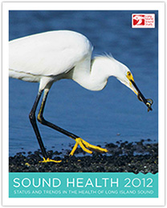
How does the Core Team Work?
Gather ideas from inside LISS for what the next CCMP needs to include through presentation, online surveys, and facilitated workshops for LISS partners and workgroups.
Five State/EPA TMDL Work Group
Habitat Restoration Work Group
Nonpoint Source Pollution & Watersheds Work Group
Sentinel Monitoring for Climate Change Work Group
Stewardship Work Group
Policy Committee
Executive Steering Committee
Management Committee
Citizens Advisory Committee
Science &Technical Advisory Committee
Notes:
Priority will be given to partners that have statutory responsibilities under the authorizing laws (e.g., CWA, CZMA, etc.); however, input will be sought from all LISS participants, interested stakeholders, and public

Slide 10
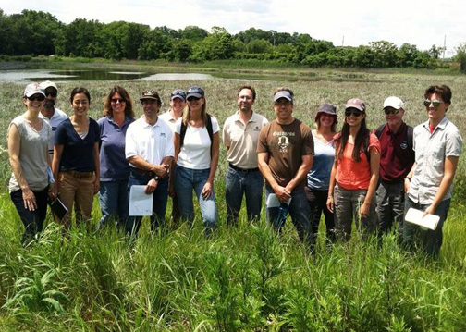
Gather Input from Outside LISS
Native tribe engagement
Public listening sessions
Stakeholder meetings/ workshops
Public comment forms
Surveys
Web-based tools
Social media outlets

Slide 11
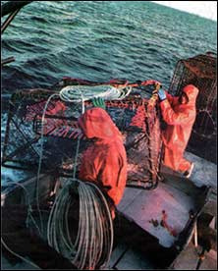
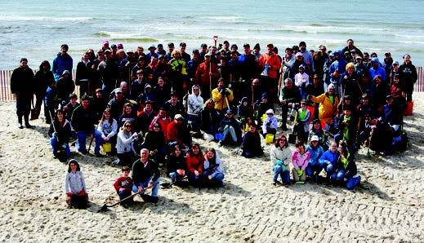
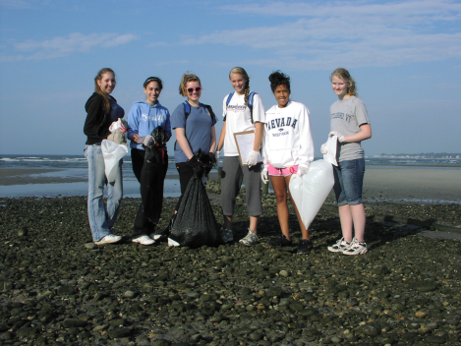
Gather Input from Outside LISS
Public Listening Sessions & Stakeholder Scoping – Collect, categorize and analyze public comments and input on the CCMP
Examples of stakeholder underrepresented groups:
Shellfish Harvesting & Aquaculture
Environmental Justice Groups
Municipalities

Slide 12
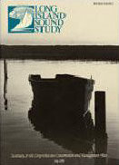
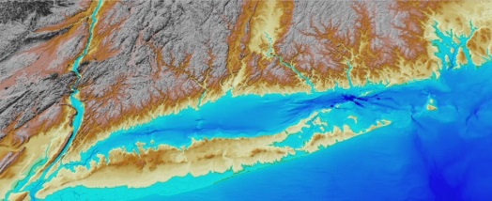
Concepts for Revision
Recognize accomplishments under the 1994 CCMP
Set 20 year horizon (with 2-5 year implementation plans)
Purpose
Be more concise & publically accessible
Emphasize big picture goals, objectives & actions
Establish new long term objectives & targets
Streamline reporting process
Continue to improve LIS environmental quality

Slide 13
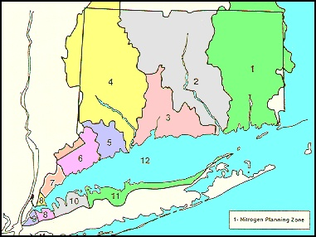
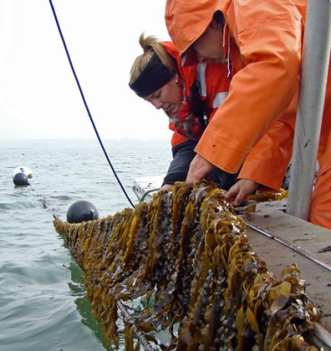
Concepts for Revision
Consider whole ecosystem and cross-jurisdictional perspectives
Include stakeholder/public input and ecosystem service concepts
Implement across local, state, region and federal levels
Emphasize resiliency of system in response to climate change
Utilize strong science (monitoring, assessment and research)
Adapt using best science and management tools
Use 4 themes for organization and develop a structure that allows for definition of measurable outcomes and a process to evaluate progress towards them.

Slide 14
Process for CCMP Structure
Themes
Goals
Outcomes
Objectives
Indicators
Targets
Actions
Each broad Theme has a defined Goal
These Goals are linked to several desired Outcomes
The Outcomes are linked to measurable Objectives with associated Indicators
Long term Targets/actions will be set with shorter interim targets/actions described in Management Implementation Plans (2-5 year targets) to measure progress

Slide 15
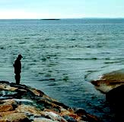
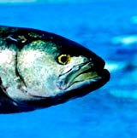
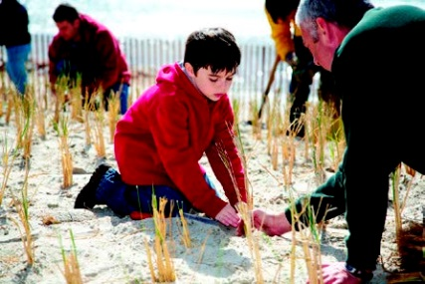
Themes
Goals
Outcomes
Objectives
Indicators
Targets
Actions
Themes: Overarching environmental/managing categories
Waters & Watersheds
Habitats & Wildlife
Sound Communities
Science & Management

Slide 16
Themes
Goals
Outcomes
Objectives
Indicators
Targets
Actions
Goals: Wide ranging purposes of theme
1. Waters & Watersheds:
Improve water quality by reducing pollutant and nutrient loads from the land and the waters impacting LIS.
2. Habitats & Wildlife:
Restore and protect the Sound's ecological balance in a healthy, productive, and resilient state for the benefit of both people and the natural environment.
3. Sound Communities:
Support vibrant, informed, and engaged communities that use, appreciate, and help protect LIS.
4. Science & Management:
Make ecosystem-based management (EBM) the foundational principle for management of LIS.

Slide 17
Theme
Goals
Outcomes
Objectives
Indicators
Targets
Actions
Outcomes: Broad results needed to achieve goals
Theme | Goal | Outcomes
Waters & Watersheds | Improve water quality by reducing pollutant and nutrient loads from the land and the waters impacting LIS. | 1-1: Policies, practices, and infrastructure are maintained and enhanced to reduce pollutant loads. 1-2: Low impact development and redevelopment maintains or restores the watershed's hydrologic and ecological functions resulting in improved health of LIS. 1-3: Protect head waters and pristine areas to ensure no degradation of inland waters leading to degradation of LIS waters. 1-4: Address sources of toxins and pathogens which impact utilization of LIS and ability of LIS to achieve fishable and swimmable status through mitigation, BMPs, and education. 1-5: Maintain and enhance monitoring of water quality and dissolved oxygen to facilitate effective adaptive management.

Slide 18
Themes
Goals
Outcomes
Objectives
Indicators
Targets
Actions
Objectives: Specific activities needed to achieve desired outcomes
Theme | Goal | Outcomes | Objectives
Waters & Watersheds | Improve water quality by reducing pollutant and nutrient loads from the land and the waters impacting LIS. | 1-1: Policies, practices, and infrastructure are maintained and enhanced to reduce pollutant loads. | Reduce nitrogen inputs which are shown to be a factor in the occurrence of hypoxia, in accordance with the Dissolved Oxygen TMDL. Improve water quality and identify and mitigate pollution sources so that estuarine areas meet water quality standards for bacteria for shellfish harvesting and bathing waters. Reduce marine and land-derived debris and its negative impacts on aesthetic and habitat value. Incorporate and implement land use/storm water Best Management Practices (BMPs) in municipal land use, re-development and resiliency planning and regulations. Ensure adoption of Best Management Practices (BMP's) to prevent or reduce nonpoint source pollution from agriculture and municipal/residential landscapes.

Slide 19
Themes
Goals
Outcomes
Objectives
Indicators
Targets
Actions
Indicators: Specific, measurable, management, outreach, and/or environmental condition variables that are required to conclude that objectives have been achieved
Theme | Goal | Outcomes | Objectives | Indicators
Waters & Watersheds | Improve water quality by reducing pollutant and nutrient loads from the land and the waters impacting LIS. | 1-1: Policies, practices, and infrastructure are maintained and enhanced to reduce pollutant loads. | LISS partners will, in accordance with the TMDL, work to reduce nutrient inputs, which is shown to be a factor in the occurrence of hypoxia. | Total N and P contributions from CT and NY WWTFs Total N and P contributions from nonpoint sources Spatial and temporal hypoxia extent

Slide 20
Themes
Goals
Outcomes
Objectives
Indicators
Targets
Actions
Targets: Quantitative value for each indicator set at a 20 year horizon compatible with goals
Theme | Goal | Outcomes | Objectives | Indicators | Targets
Waters & Watersheds | Improve water quality by reducing pollutant and nutrient loads from the land and the waters impacting LIS. | 1-1: Policies, practices, and infrastructure are maintained and enhanced to reduce pollutant loads. | LISS partners will, in accordance with the TMDL, work to reduce nutrient inputs (eutrophication), which is shown to be a factor in the occurrence of hypoxia. | Total N and P contributions from CT and NY WWTFs Total N and P contributions from nonpoint sources Spatial and temporal hypoxia extent | X kg/year of N and Y kg/yr P from CT and NY WWTFs X kg/year of N and Y kg/yr P from nonpoint sources X% reduction in spatial and Y% reduction in temporal extent of hypoxia

Slide 21
Themes
Goals
Outcomes
Objectives
Indicators
Targets
Actions
Actions: Broad tasks needed for implementation to achieve targets
Theme | Goal | Outcomes | Objectives | Indicators | Targets | Actions
Waters & Watersheds | Improve water quality by reducing pollutant and nutrient loads from the land and the waters impacting LIS. | 1-1: Policies, practices, and infrastructure are maintained and enhanced to reduce pollutant loads. | LISS partners will, in accordance with the TMDL, work to reduce nutrient inputs (eutrophication), which is shown to be a factor in the occurrence of hypoxia. | Total N and P contributions from CT and NY WWTF | X kg/year of N and Y kg/yr P from CT and NY WWFs | Continue efforts to monitor and assess the impact of early reductions to WWTF loads. Implement further reductions using an adaptive framework. Understand the N-load coming from NPS and storm water sources, begin tracking the effectiveness of practices that reduce NPS and storm water N-loads, and fund implementation of successful practices to further reduce N-loads in coordination with the CCMP.

Slide 22
Examples of Indicators and Trends

Slide 23
Point Source Nitrogen Trade-Equalized Loads 1995-2012 106 NY/CT STPs
Target
Notes:
From Robert (graph from Salata) The red line is the goal to reduce nitrogen at the levels established by the TMDL. The yellow bars are the projected reduction levels for the final two years of the TMDL. Westchester and New York City have received extensions to meet their target levels by 2017, but we still go by this chart.

Slide 24
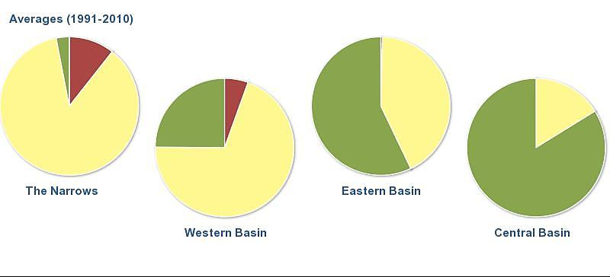
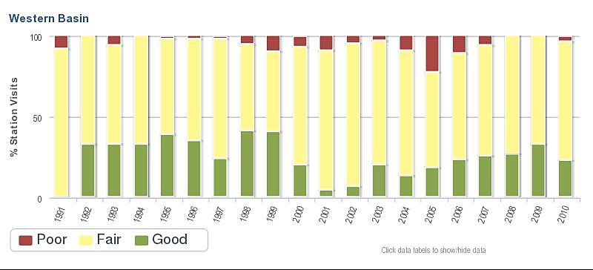
Water Quality Index
EPA’s NCA Index based on 5 chemical & biological measures:
Nitrogen
Phosphorus
Chlorophyll
Dissolved
Oxygen Water Clarity

Slide 25
Coastal Habitats Restored

Slide 26
Piping Plover Nesting Pairs

Slide 27
Where can I learn more and how can I provide input?
LISS CCMP Website: http://longislandsoundstudy.net/ look at “plan update” in the News Room
Long Island Sound Study Update Facebook https://www.facebook.com/LISSplanupdate
Join the Long Island Sound Study Update discussion on LinkedIn http://www.linkedin.com/groups/Long-Island-Sound-Study-Plan-4995384/about
Follow us on Twitter @PlanUpdate
To provide input please send email to: contact@watervisionllc.com
Theme | Core Team Champion
Waters and Watersheds | Sarah Deonarine, Mark Parker & Jason Krumholz
Habitats and Wildlife | Harry Yamalis, Georgia Basso, & Victoria O’Neill
Sound Communities | Robert Burg , Amy Boyajian, & David Miller
Science and Management | Mark Tedesco, Larry Swanson, & Jim Latimer

